Slide 1
Alternative options for dot collections
Mobile Testing

Slide 2
Greater new haven transit district
The Greater New Haven Transit District (GNHTD) serves 21 New Haven area municipalities and has 10 member towns. The district serves individuals with a permanent or temporary disability as well as anyone from a member town who is over the age of 65 or has a disability.

Slide 3
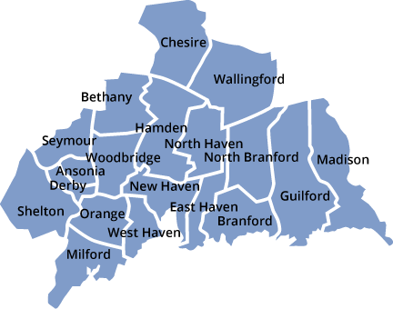
Greater new haven transit district
State of Connecticut.
Total Staff: 140
Safety Sensitive: 115
Total Fleet: 92
We serve the New Haven Region

Slide 5
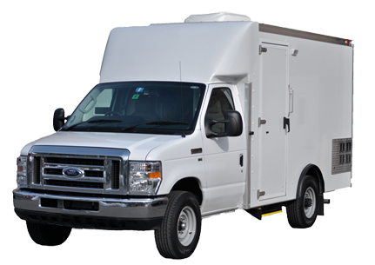
What is mobile testing
Drug and/or alcohol testing that is conducted in a movable vehicle that meets all the requirements of a traditional collection site.

Slide 6
Why mobile testing
A drug-free workplace is critical. An excellent way to be sure employees are productive, safe and trustworthy is by implementing an effective drug and alcohol testing program.
Some benefits of an effective drug and alcohol testing program utilizing mobile testing are:
Available 24 Hours a Day, 7 Days a Week
Mobile On-Site Testing
Random Breath Alcohol Testing
Random Drug Testing
Limits down time and keeps employees in the field
Contained Environment

Slide 7
Why mobile testing
Convenient specimen collection and chain of custody procedures
Discretion and Confidentiality
Zero advanced notice
Less Opportunity for Cheating – Reduces opportunities for the employee to try and dilute a sample by drinking excess amounts of water ahead of time. It also prevents employees from stopping on their way to a collection site to retrieve a clean urine sample or obtain adulterants.
Holiday Draw – Effective and unexpected

Slide 8
Implementing random mobile testing
Getting buy in….From the top down
Location, Location, Location
Communication
Point of Contact
Minimalist…Confidentiality – The inner circle
Training

Slide 9
Team Buy in…from the top down
CEO/GM
Management Team/ Department Heads
Operations Team
Supervisors
Dispatchers

Slide 10
Choosing testing locations
Central locations within your service area
4-5 locations based on the size of your system

Slide 11
Communication is key
Scheduling Department of Testing unit
Phone Scheduling
Email Confirmation
Agency Supervisors
Up to 1hr planning time
Keep line of communication open
Mobile unit team on location

Slide 12
Point of contact
Drug and Alcohol Program Manager/Designated Employer Representative
Alternate Drug and Alcohol Program Manager/Designated Employer Representative

Slide 13
Training & Flexibility
Supervisor Training
Dispatchers

Slide 14
Challenges and pitfalls
If practical/ possible: Drug and Alcohol Program should not be a function in Operations but in the safety department
Getting Buy in
Confidentiality
Missed Test

Slide 15
Our Partners

Slide 16
King County Proposal
Pilot Program - In-House Drug Test Collection and Breath Alcohol Testing
Presented by Lori Jones
Lori.jones@kingcounty.gov
March 2019

Slide 17
Drug & Alcohol Program Overview
King County Drug/Alcohol Testing & Education Program Office
4500+ Safety Sensitive Employees
11,000+ Non-safety sensitive Employees
County operation – 24/7
D/A Program staff – 4 FTE

Slide 18
Drug & Alcohol Program Overview
King County Drug/Alcohol Testing & Education Program Office
Responsible for Safety Sensitive Drug/Alcohol Testing – FTA, FMCSA & USCG
Policy
All test types
Training
Management Consultation & Assistance
Contractor/Service Agent Oversight
Sub-Contractor Random Testing Pool

Slide 19
Drug & Alcohol Program Overview
King County Drug/Alcohol Testing & Education Program Office
Responsible for Non-safety sensitive Drug/Alcohol Testing
Policy
Reasonable Suspicion / Return to Duty / Follow-up
Training
Management Consultation & Assistance

Slide 20
Drug & Alcohol Program Overview
King County Drug/Alcohol Testing & Education Program Office
2019 Testing projection – DOT & Non-DOT tests
4000 – Drug tests
700 – Breath Alcohol Tests

Slide 21
Drug & Alcohol Program Overview
King County Drug/Alcohol Testing & Education Program Office
Currently utilize two Service Agents – one contract
Clinics – M-Sat days - Urine Collection / BAT
After hours – On-call collectors – Urine Collection / BAT
After hours – Hospital lab – Urine Collection / Saliva alcohol only
Random selection – Three pools

Slide 22
Drug & Alcohol Program Overview
King County Drug/Alcohol Testing & Education Program Office
Contract Value - $199,339 (Annually) – Awarded 2017
Opportunity to request price increase annually
No control over service agents
Costs
Hours of operation
Staffing levels
Quality of Service provided

Slide 23
Industry Review
Review of several transit systems in United States
Variety of options identified:
Complete in-house program – included Collection, BAT & MRO
Partial in-house – BAT only, collections performed at Service Agent
On-site testing – Collection & BAT using Service Agent
External Collection sites/hospital – Collection, BAT & Saliva Alcohol testing

Slide 24
Industry Review
Others also expressed interest in bringing collection/BAT in-house
Reasons identified:
Lack of control – performance and cost
Missed tests
Paperwork errors
Time loss

Slide 25
Industry Review – Four Systems
Regional Transit District (RTD) Denver, CO
Implemented 2013 – in-house drug test collection & BAT
Improved quality, decreased time loss, budget neutral
Collection & BAT @ main office and other worksites
No identified risks
Unions & management accepted
Regional Transportation Authority (RTA) Rochester, NY
Implemented 2011 – in-house drug test collection, BAT & MRO review
Also performs fit for duty & DOT physical exams in house
Improved quality, decreased time loss
Main office and five satellite worksites
No identified risks
Unions & management accepted

Slide 26
Industry Review – Four Systems
Pierce Transit – Tacoma, WA
Partial in-house program – BAT only
Improved quality, timeliness & access to testing
BAT performed on site by Drug/Alcohol Program staff
No identified risks
Unions & management accepted
Community Transit – Everett, WA
On-site collection and BAT – performed by Service Agent
Scheduled afterhours Random testing
Non-scheduled Post Accident & Reasonable Suspicion - afterhours
No formal risk assessment – potential risk of service agent falling on premises
Unions & management accepted

Slide 27
Problem Statement
Managers express frustration regarding employee time loss due to Drug/Alcohol testing including:
Costs associated with time loss
Service Issues – Clinics
Issues – Afterhours Collection site
Management has requested a more efficient way to meet the mandatory testing requirement

Slide 28
Problem Statement
Costs associated with time loss
Travel time – 15min-60min
Limited & decreasing clinic hours
Supervisory escort to after hours facility
Increased time to schedule appointments

Slide 29
Problem Statement
Service Issues – Clinics
• Wait Times –
- Average wait time is 46 minutes before services
- Often exceed 75 minutes in waiting area
Paperwork Errors –
- Multiple errors on CCF & ATF
- Daily requests for correction on DOT and non-DOT paperwork
• Missing Paperwork / Missed tests –
- Employer copy of CCF & ATF not received
- Test order not followed – missed tests

Slide 30
Problem Statement
Issues – Afterhours Collection site
Requires supervisory escort
No Evidential Breath Measuring Device –
Saliva alcohol testing only
No Observed Collections –
Will not perform DOT Follow Up testing (observed)
Will require KC staff to observe if required on other test types
Paperwork Errors / Missing paperwork –
Errors on CCF & ATF – requires corrections
Employer copy of CCF & ATF not received

Slide 31
Recommendation
Implement in-house urine collection and breath-alcohol testing within the Drug/Alcohol Program
3 year Pilot Program
Add three FTE and two PTE Drug/Alcohol Technician to the Drug and Alcohol Program
Perform drug test collections and breath-alcohol testing 24/7 at the KC Drug/Alcohol office and/or at KC worksites
Moving this work to KC staff will result in a reduction of cost with decreased time loss and improved quality control

Slide 32
Recommendation
Implement in-house urine collection and breath-alcohol testing within the Drug/Alcohol Program
Three phase process
Phase 1 –
Purchase Evidential Breath Measurement Devices
BAT/Collector training – 5 people
Obtain 3 quotes for each – Lab & MRO services
Select Laboratory and MRO services and negotiate/sign contracts
Recruit / Hire D/A Technicians
Add additional work stations (desk, phone, computer) for staff
Notification to departments, divisions and unions

Slide 33
Recommendation
Implement in-house urine collection and breath-alcohol testing within the Drug/Alcohol Program
Three phase process
Phase 2 –
Implement pilot program for some drug test (urine collection) and breath alcohol testing currently performed by service agent
After hours/Weekends/Holidays @ KSC or Transit Base
Marine Division @ KSC
Pre-Employment - Transit Operator only drug testing (urine collection) @ KSC
Reasonable Suspicion and Return to Duty – All @ KSC
Maintain current contract with service agent for duration of contract (March 2022)

Slide 34
Recommendation
Implement in-house urine collection and breath-alcohol testing within the Drug/Alcohol Program
Three phase process
Phase 3 –
Hire remaining FTE & PTE Drug/Alcohol Technicians
Implement pilot program for majority of urine collections and BAT with few exceptions
Pre-employment – out of area
Pre-employment – Non-transit – at department/division request
All other tests types - Non-transit – at department/division request
Maintain current contract with service agent for duration of contract (March 2022)

Slide 35
Benefits
Significantly reduce the wait time associated with testing
Diminish budget impact to departments associated with time loss
Increase employee availability to deliver safety sensitive work
Potential improved cycle time to hire Transit Operators
Increase quality of work with greater control and oversight of collections and alcohol testing

Slide 36
Benefits
Increase availability and locations for testing 24/7
Decrease collection errors, missed tests and reduce paperwork issues
Potential opportunity to offset cost by offering collection/BAT testing in Seattle to
Community Transit
Pierce Transit and
KC Transit contractors providing Access and DART service

Slide 37
Next Steps
Reviewed by Risk, PAO and OLR
Present to Dept. Director for consideration of Pilot Program
Budget request development, based on Dept. Director feedback
Consider possible drug/alcohol test areas (single stall bathroom, water access outside, aural/visual privacy area) in base expansions and/or health wellness centers
If approved, begin three Phase process to implement pilot program

Slide 38
King County Proposal
Thank you

Slide 39
The Benefits & How-To’s of In-House Drug and Alcohol Testing
Julie Tennant, Drug and Alcohol Program Manager
Rochester-Genesee Regional Transportation Authority
Rochester, NY

Slide 40
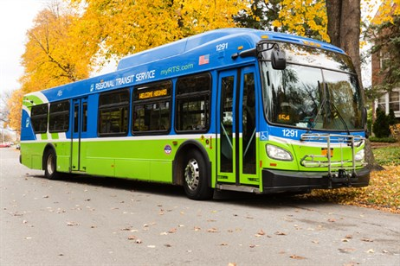
A Little Bit About RGRTA
900+ employees, 750+ safety-sensitive employees
425 buses
Providing public transportation for 8 counties, including paratransit, dial-a-ride and fixed route line service
24/7, 365 day service

Slide 41
Benefits of In-House Drug Testing
Greater compliance with Federal Regulations
Accuracy
Timely Communications and Action
Cost Savings
Fewer Errors
More Control Over the Testing Process
Consistency
Employees earn extra money

Slide 42
Before we move on…

Slide 43
To prove this works, here are our stats:
We have an over 99% accuracy rate on all ATFs and CCFs
In 2018, we performed 643 alcohol tests and 1,255 drug tests
Our last audit produced 4 findings total, all minor and correctable
Average breath alcohol test cost:
$.36/test in materials
$1.67/personnel cost
TOTAL COST: $2.03/test
Average drug test cost:
$12.50/test (includes kit, forms, courier, urinalysis)
$7.22/personnel cost
TOTAL COST: $19.72/test

Slide 44
Questions for the audience
What are your current complaints about the party who performs your drug and alcohol testing?
How much do you pay for testing?
During regular business hours
Afterhours and weekends

Slide 45
Here’s how we do it

Slide 46
Track One: “Great People”
Lyrics
Verse 1: Drug and Alcohol Program Manager
Certified by Intoximeters as a BAT/Collector Instructor and Calibration Technician
Provides Training and Certification to all BATs & Collectors
Intoximeters online course
Classroom learning
Mock Tests
Refresher Training and Re-Certification
Verse 2: Occupational Health Specialist and Five Awesome Collectors/BATs
Full-Time Occupational Health Specialist- performs daytime drug tests
Trained/Certified/Supervised by DAPM
On-Call one weekday per week and every 5th weekend
All collectors/BATs members of the HR Team (non safety-sensitive and confidentiality)

Slide 47
Track Two: “The Superstructure”
OHS Office (Paperwork, eye exams)

Slide 48
Waiting Room

Slide 49
Drug Testing Room

Slide 50
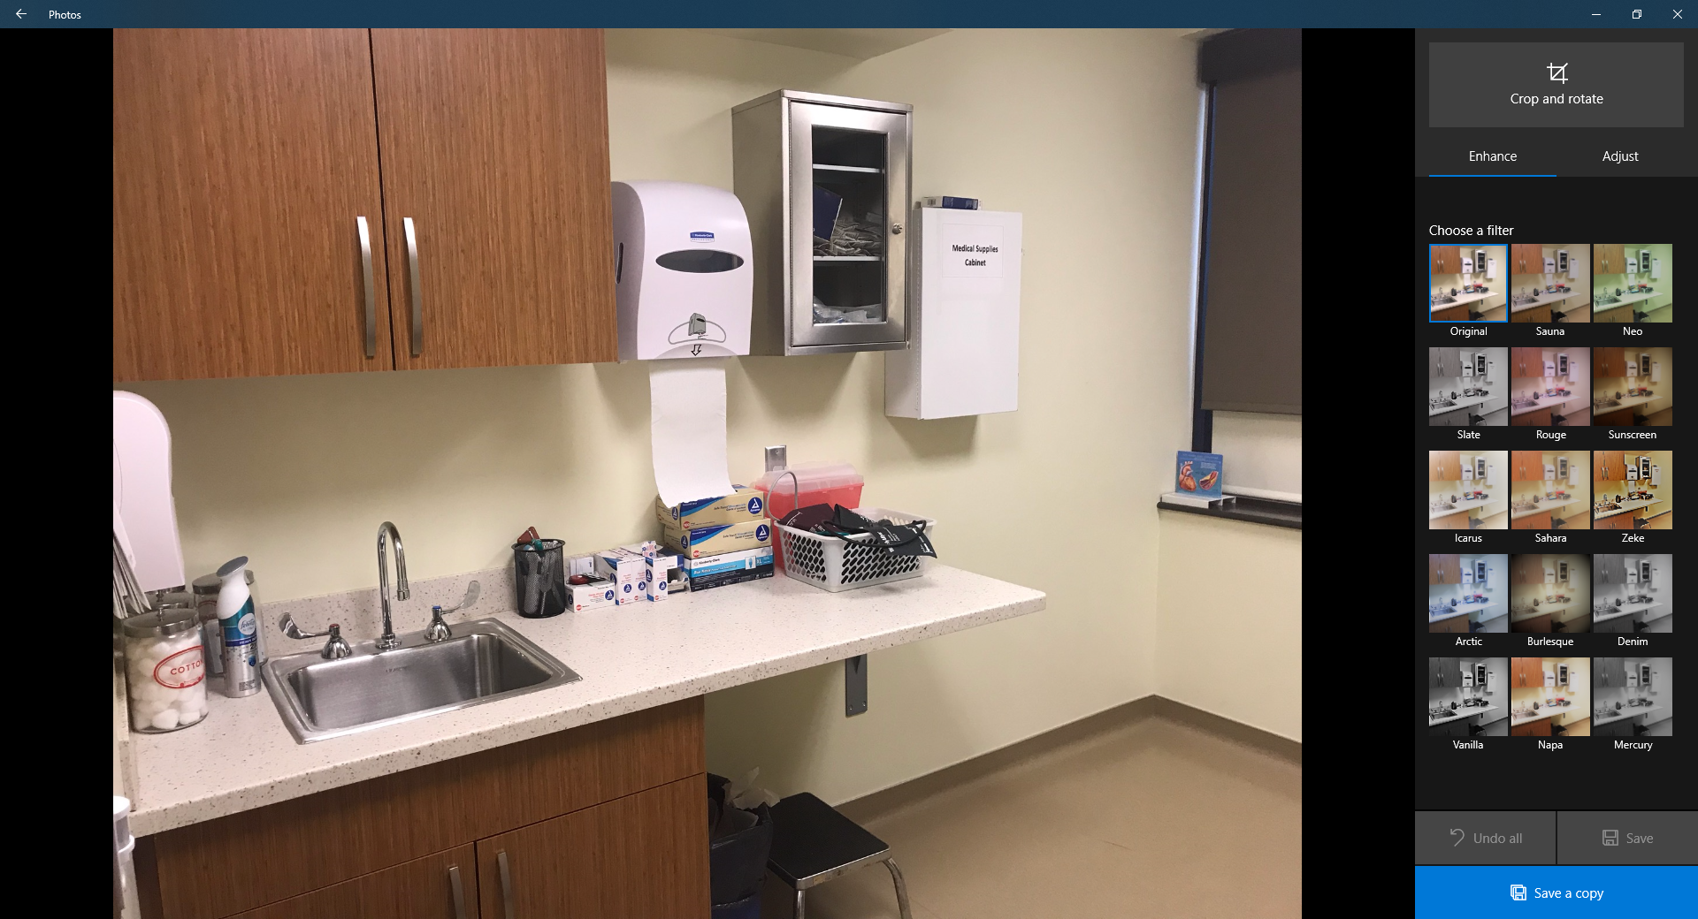
Exam Room

Slide 51
Provider’s Office

Slide 52
Drug Testing Restroom

Slide 53
Track Three: “On-Call”
5 members of HR Team (all certified as BATs/Collectors)
Financial Stipend for On-Call: 50/100
On-Call Agreement
Refresher Training
On-Call Schedule
The Procedure

Slide 55
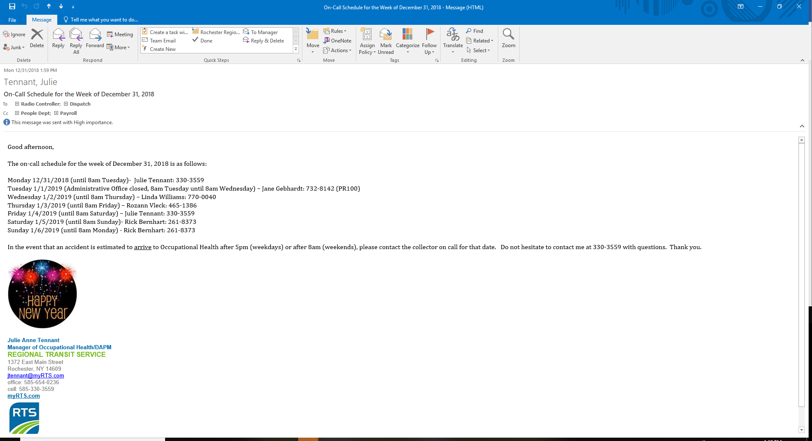
The On-Call Calendar
Email Notification

Slide 56
Track Four: “Effective Processes & Communication”

Slide 57
Daytime Accidents
Afterhours/Weekend Accidents

Slide 58
Questions?

